Slide 1
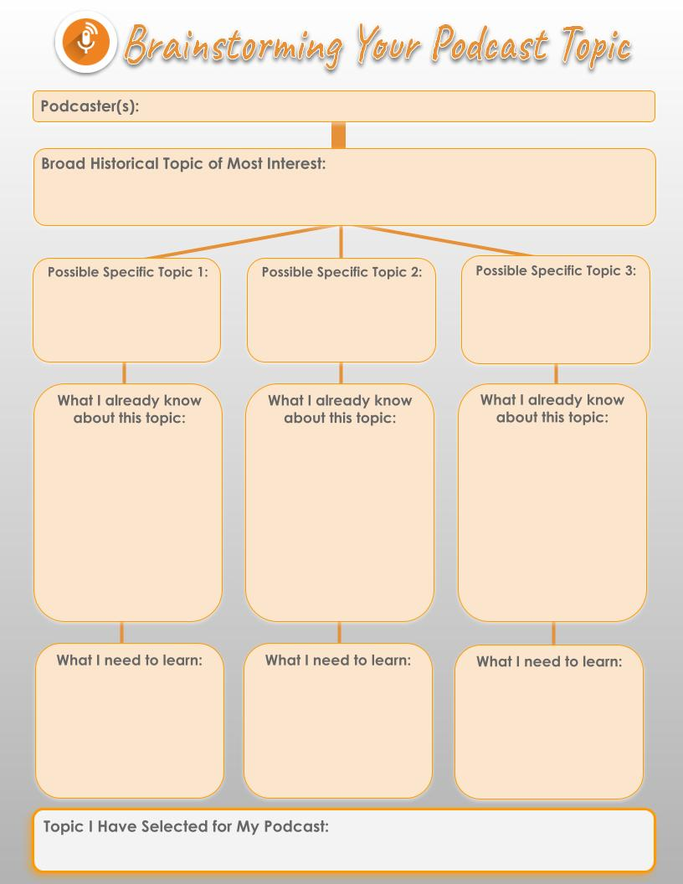
Lissa Brenner
Evidence-based interventions that may help prevent suicide among Veterans with traumatic brain injury.
Suicide among veterans with Traumatic brain injury
Possible interventions to address the risk of suicide among veterans with TBI
Veterans with a history of traumatic brain injury, or TBI, were twice as likely to die by suicide compared with veterans without history of TBI
Close monitoring for suicidal ideation and behavior among veterans significantly reduces the risk of suicide.
How does homelessness enhance the risk of suicide among veterans with TBI
Explore the differences in psychiatric oucomes among veterans without a history of traumatic brain injury (TBI) seeking homeless services.
Veterans with multiple brain injuries twice as likely to consider suicide, compared with those with one or none

Slide 2

Evidence-Based Interventions and TBI
Evidence-based interventions that may help prevent suicide among Veterans with traumatic brain injury
History of comorbid and psychiatric conditions, including mood disorders, bipolar disorder, psychotic disorder, PTSD, anxiety disorder and substance use disorders among war veterans

Slide 3

Traumatic brain injury, psychiatric diagnoses, and suicide risk among Veterans seeking services related to homelessness
Those with a history of TBI are more likely to be at risk for suicide than those without a history of TBI.
Homelessness significantly enhances the risk of developing suicidal ideas among war veterans with underlyng mental conditions

Slide 4

Traumatic Brain Injury and Attempted Suicide Among Veterans of the Wars in Iraq and Afghanistan
War veterans with underlying menttal conditions should be closely monitored to reduce the risk of developing suicidal behaviors among war veterans.
Psychiatric comorbidity among war veterans is closely associated with posttraumatic stress disorders and attempted suicide

Slide 5

Traumatic Brain Injury
Veterans Integrated Service Network 19
General Audience
The purpose of this podcast is to inform relevant government stakeholders on the best mechanisms on which to address the issue of mental illness among the war veterans in order to reduce possible suicide ideation
Understanding veteran’s history life history of TBI significantly helps in preventing future deaths by suicide
Rehabilitative programs may be beneficial for homeless veterans with history of TBI
The prime point of intervention is at the level of thinking about suicide and focuses particularly on identifying characteristic of veterans who are more likely to think of suicide as the highest priority

Slide 6
References
Martin, E. M., Lu, W. C., Helmick, K., French, L., & Warden, D. L. (2008). Traumatic brain injuries sustained in the Afghanistan and Iraq wars. Journal of Trauma Nursing| JTN, 15(3), 94-99.
Brenner, L. (2021). Podcast: Evidence-Based Interventions and TBI. Hsrd.research.va.gov. Retrieved 18 June 2021, from https://www.hsrd.research.va.gov/news/podcasts/listen.cfm?ID=19.
TBI may increase suicide risk among veterans. Healio.com. (2021). Retrieved 18 June 2021, from https://www.healio.com/news/psychiatry/20190812/tbi-may-increase-suicide-risk-among-veterans.
Brenner, L. A., Hostetter, T. A., Barnes, S. M., Stearns-Yoder, K. A., Soberay, K. A., & Forster, J. E. (2017). Traumatic brain injury, psychiatric diagnoses, and suicide risk among Veterans seeking services related to homelessness. Brain injury, 31(13-14), 1731-1735.
Richman, M. (2021). Study: Veterans with multiple brain injuries twice as likely to consider suicide, compared with those with one or none. Research.va.gov. Retrieved 18 June 2021, from https://www.research.va.gov/currents/1118-Veterans-with-multiple-brain-injuries-twice-as-likely-to-consider-suicide.cfm.

